Slide 1
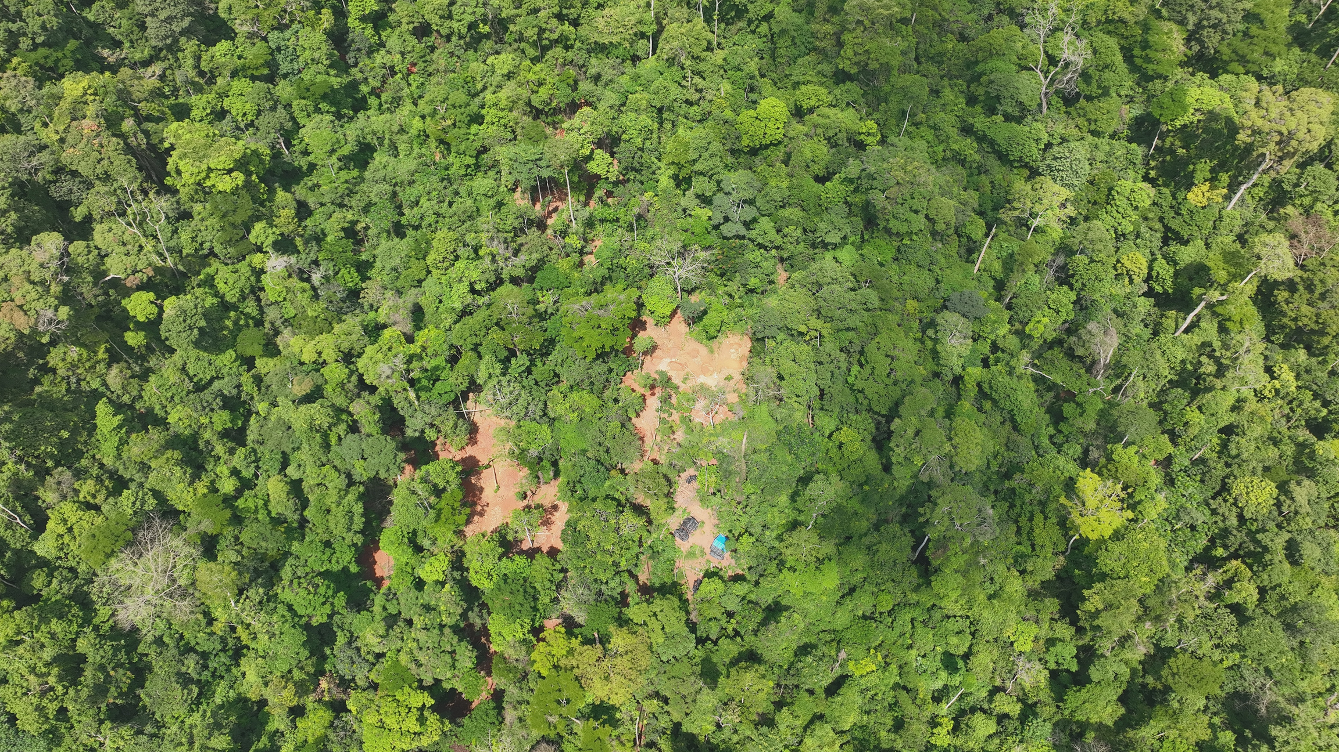


ATEWA FOREST AT TIPPING POINT OF SURVIVAL
14TH SEPTEMBER 2026

Slide 2
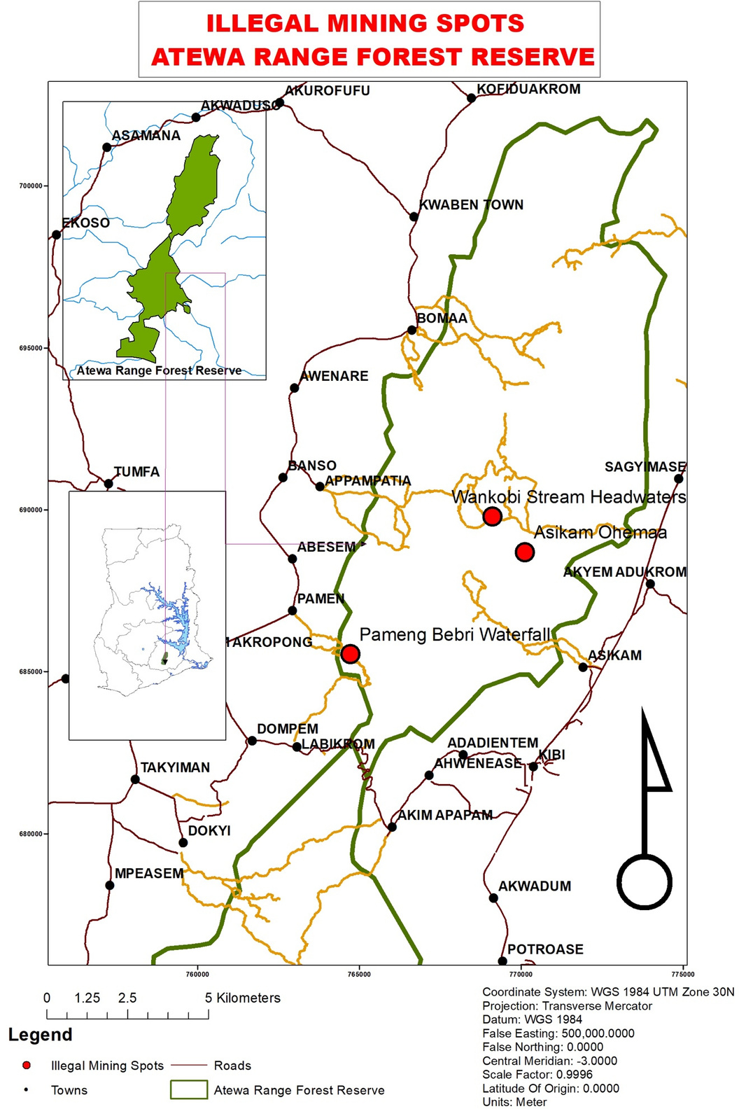
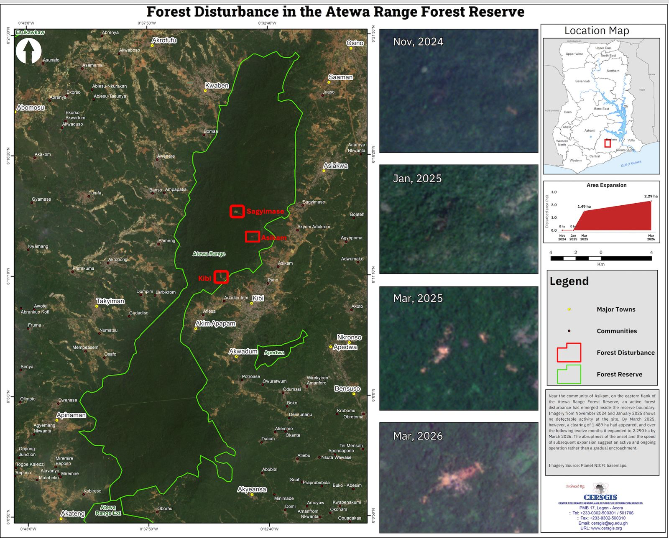

Slide 3
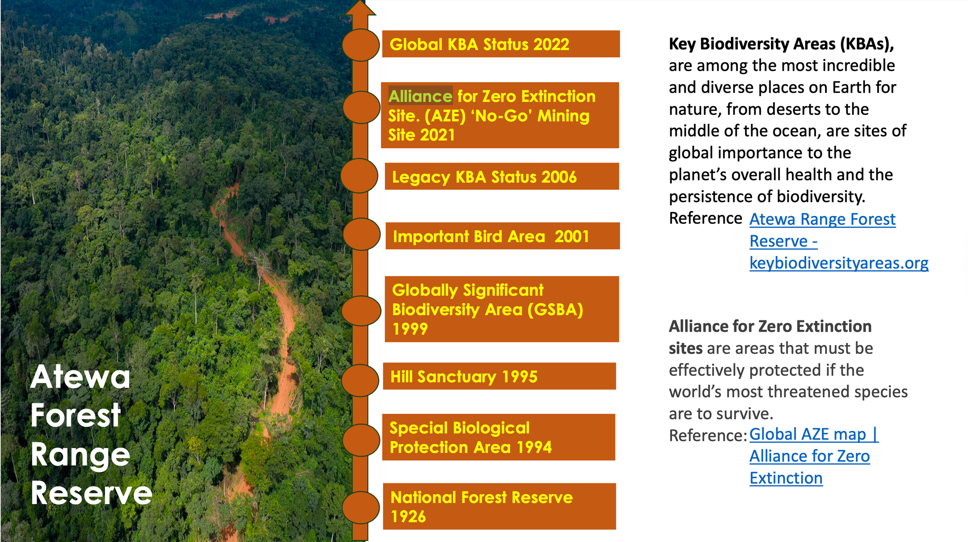

Slide 4
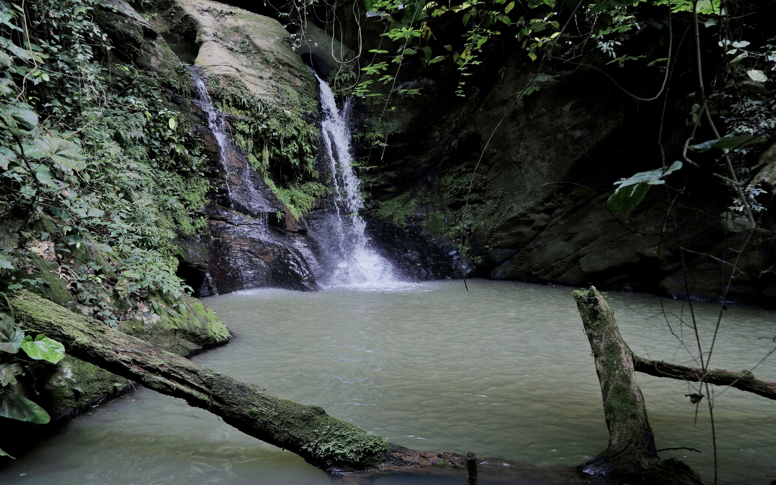
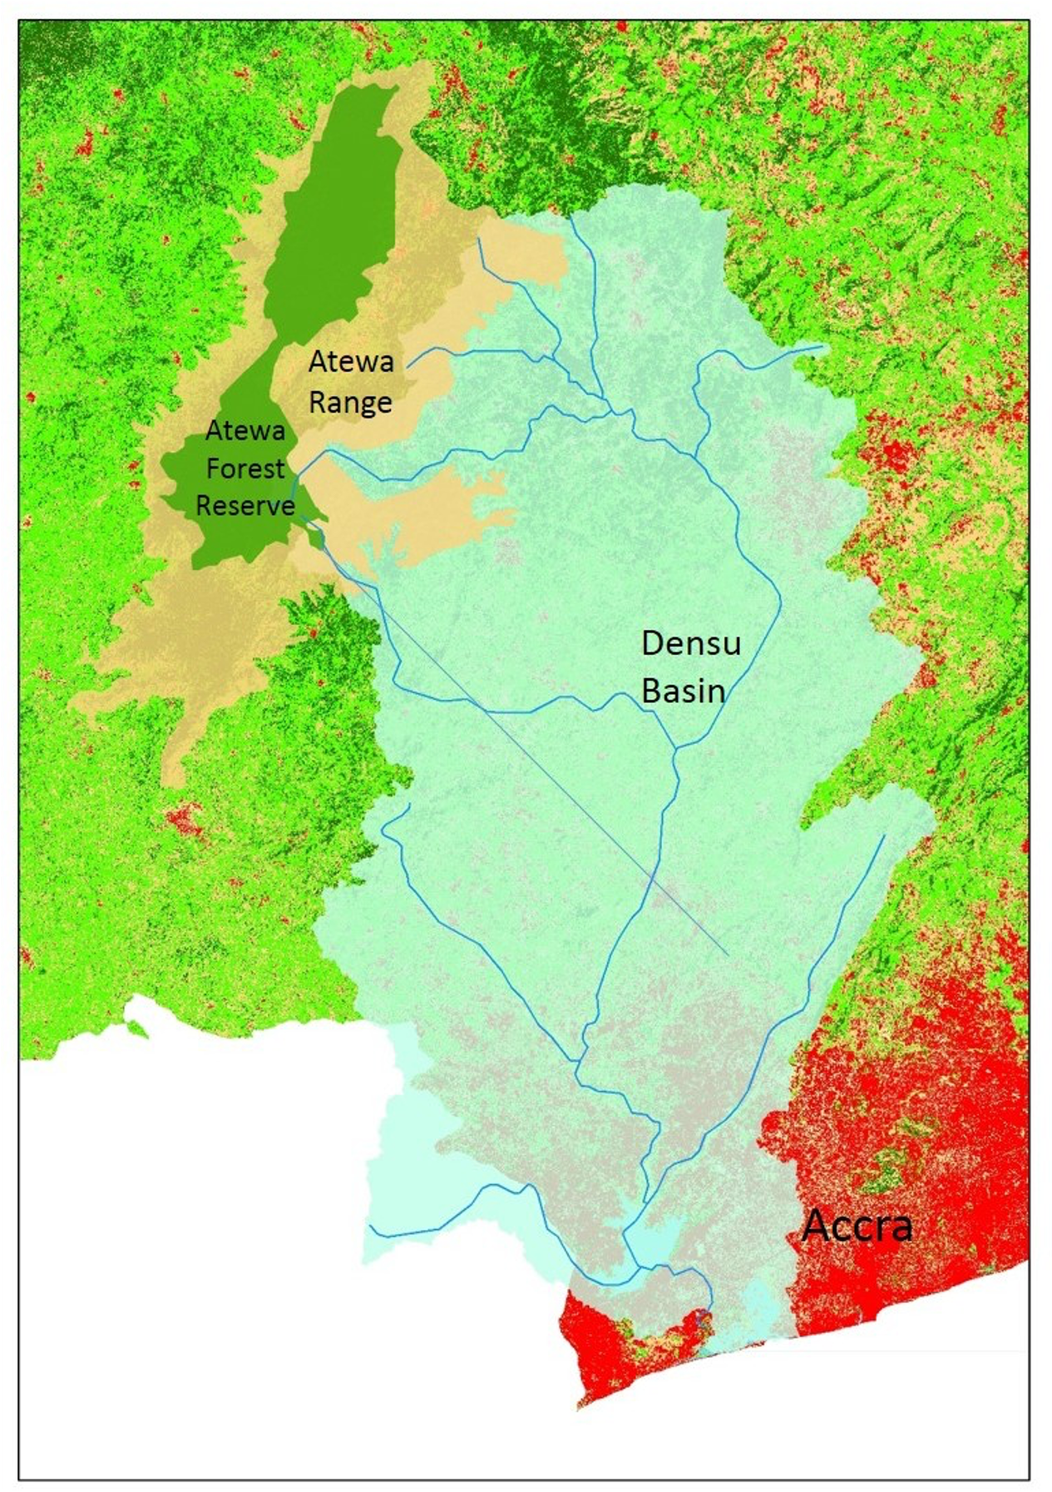
Ecosystem Services Provisioning
Atewa means source of many rivers
Source of Densu, Birim and Ayensu and over 100 other streams and rivers
Densu, Birim and Ayensu: potable water for over 5.0m people
Raw water $ 25 million per annum
Precipitation - income of $9.2m from only cocoa
Climate Resilience within the Eastern Region and environs.

Slide 5
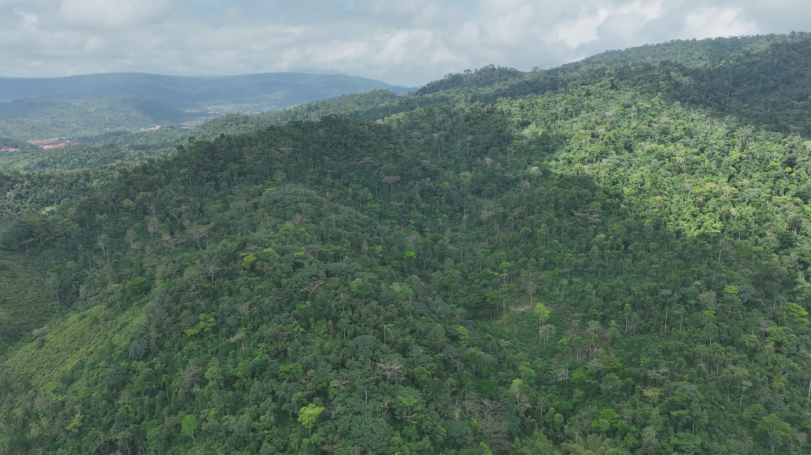

Beautiful from the skies

Slide 6
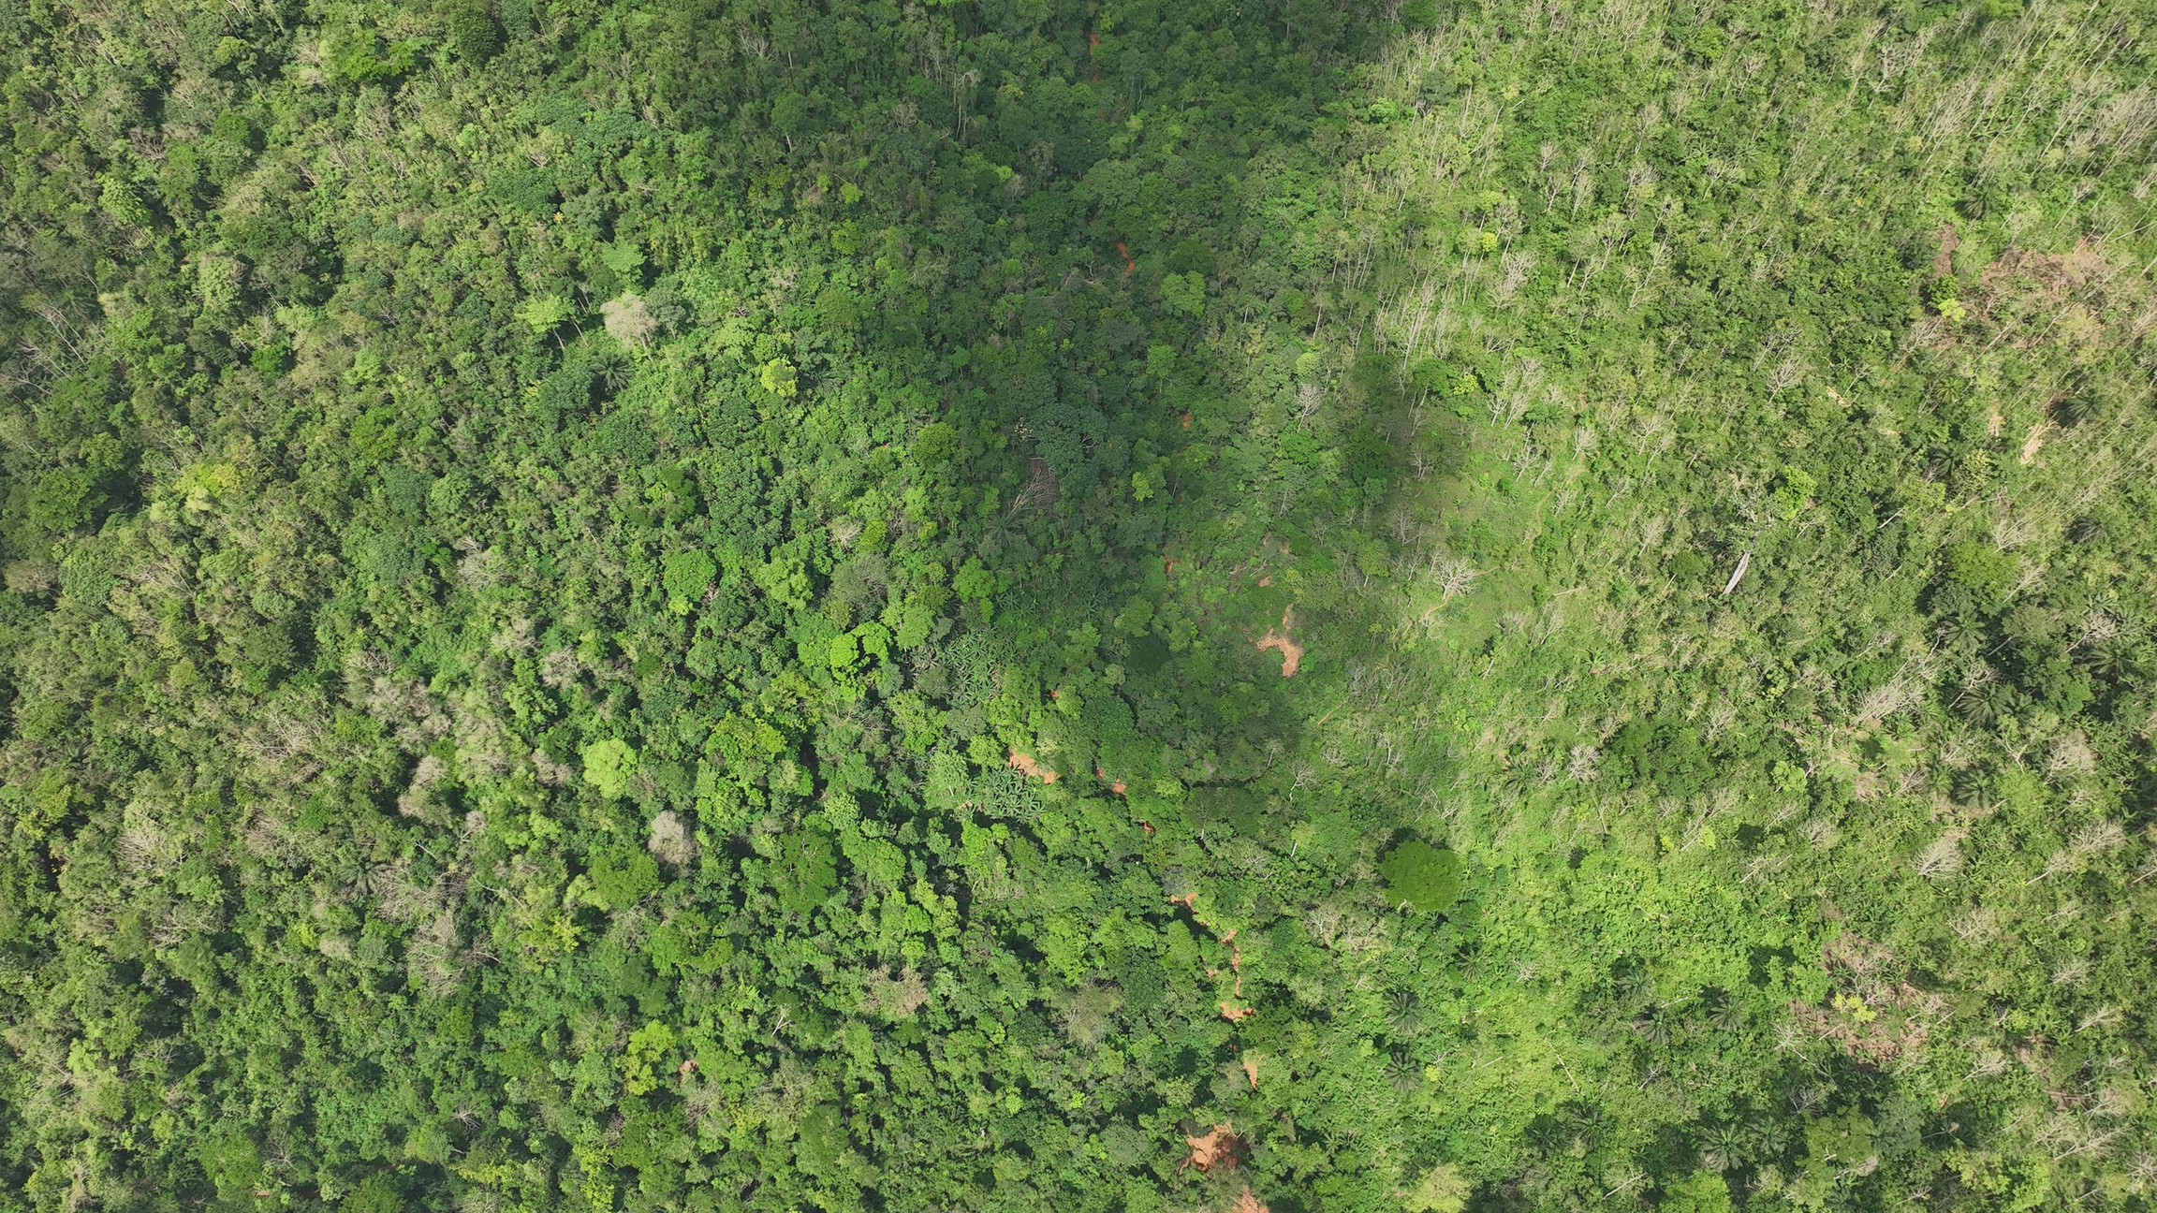

Slide 7
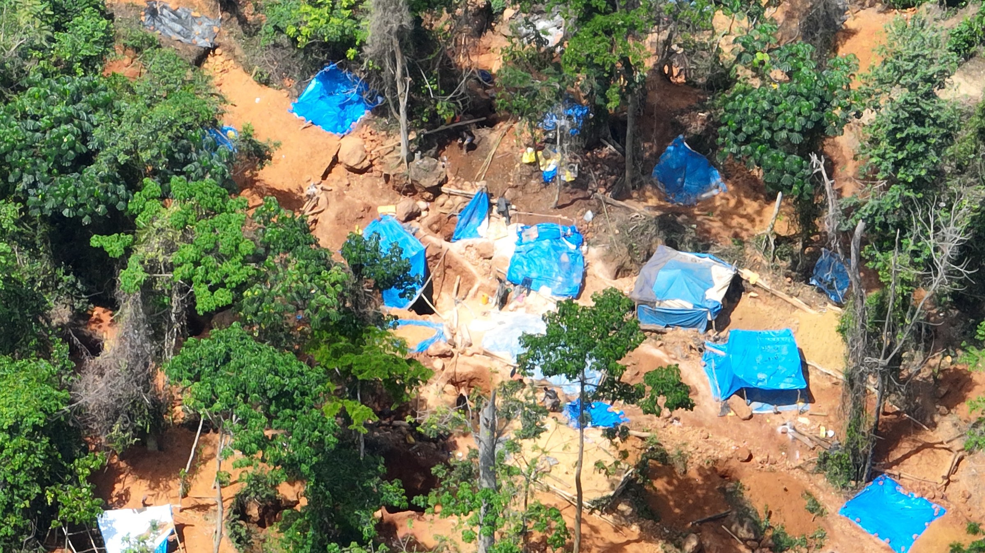

Slide 8
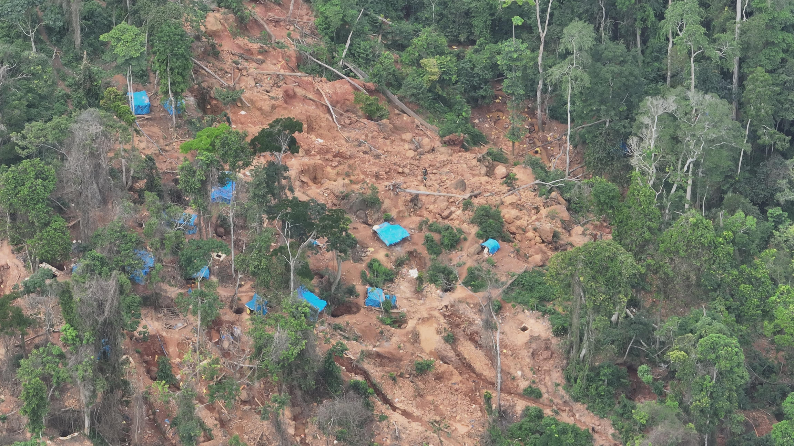

Slide 9
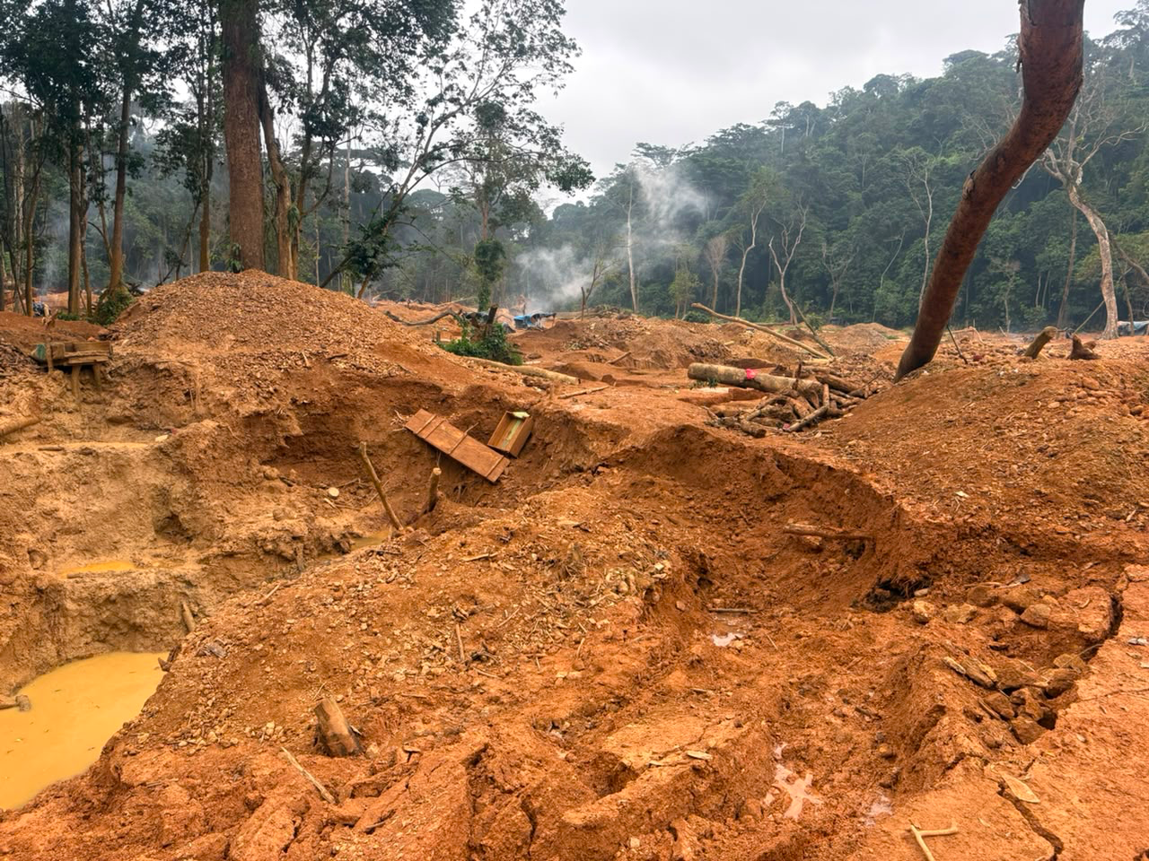

Slide 10
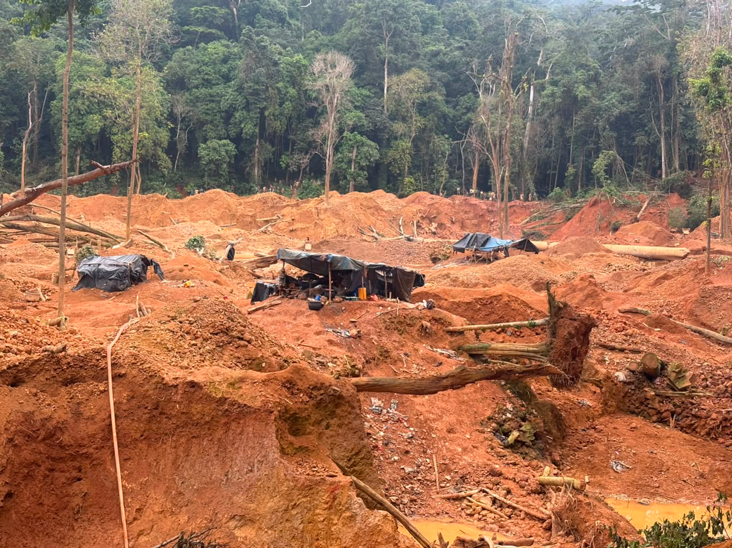

Slide 11
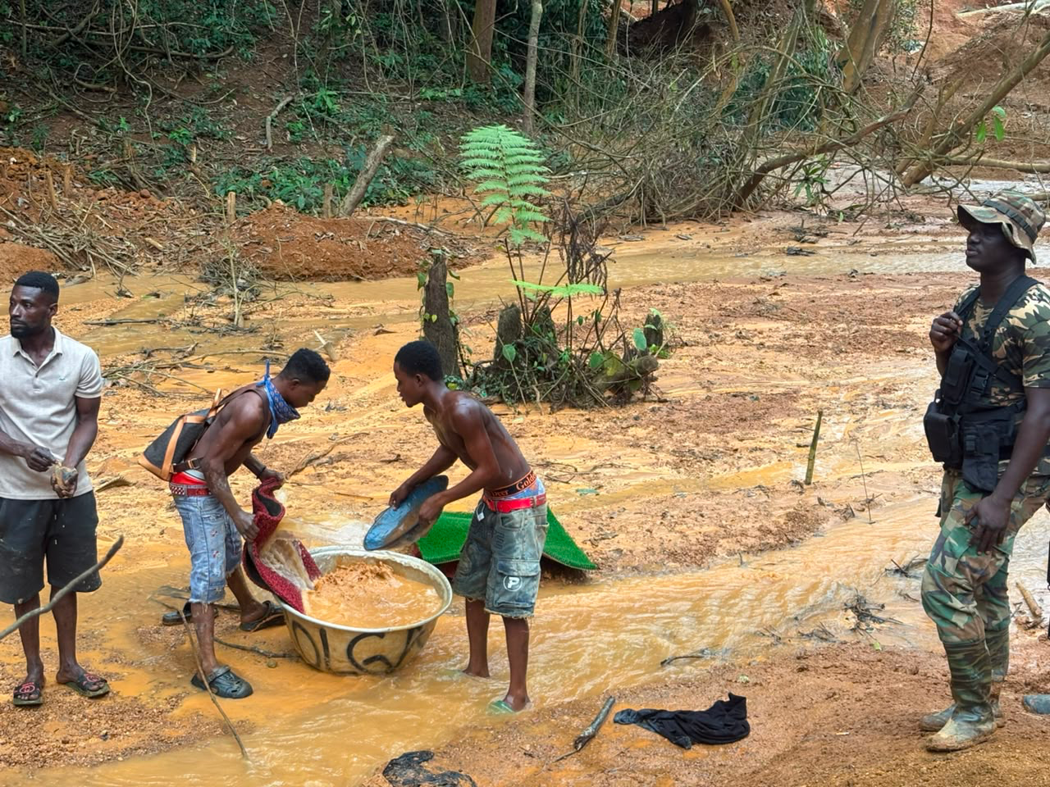

Slide 12
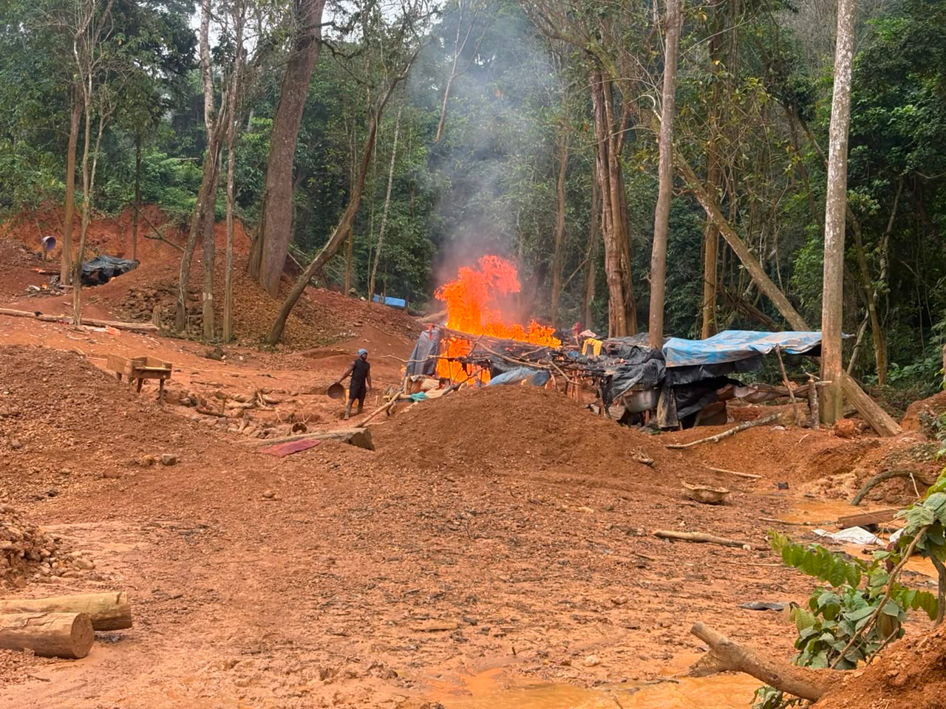

Slide 13
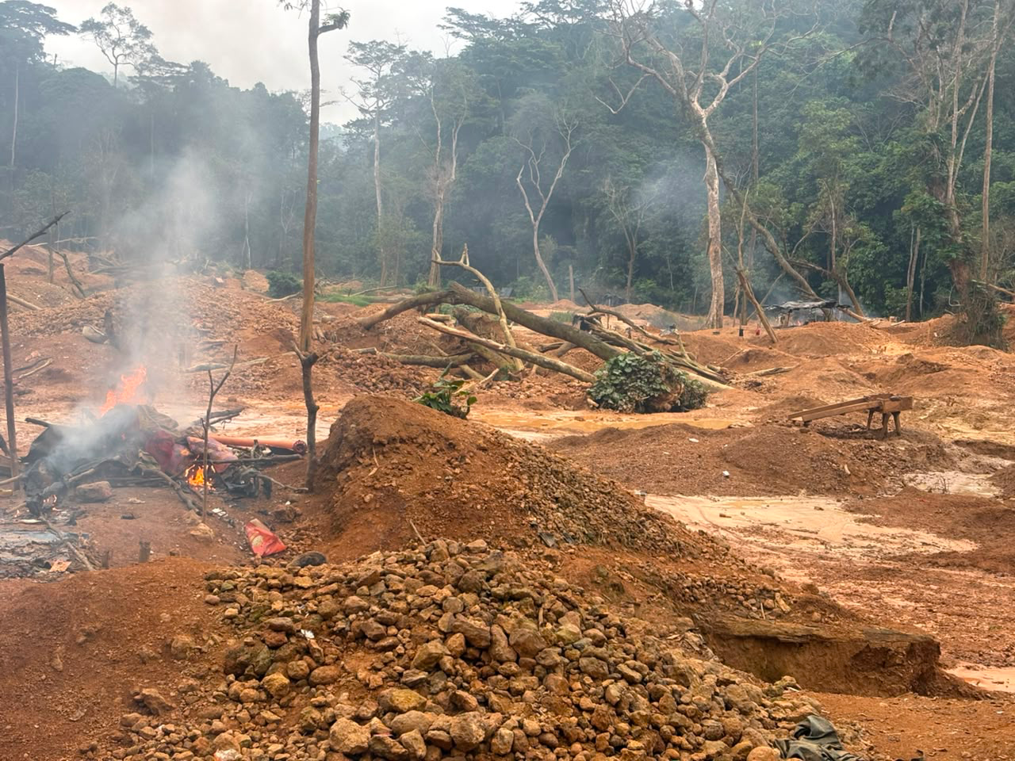

Slide 14


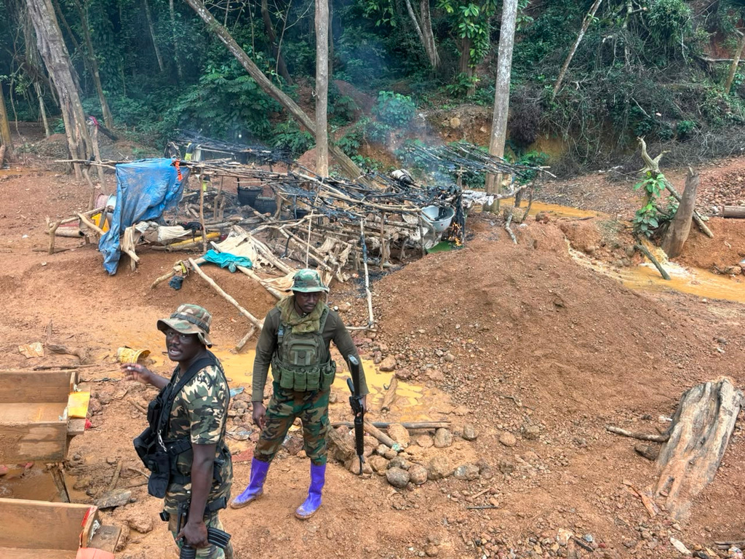

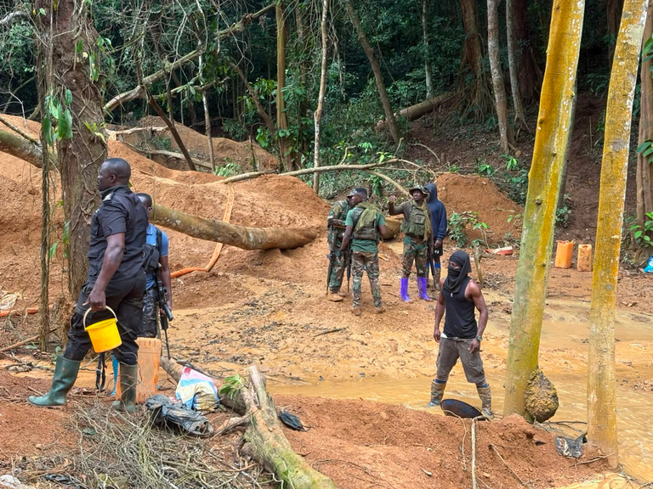
Enforcement Overwhelmed

